Slide 1
Movie Recommendation System
By
Sravanthi Kapu
skapu001@odu.edu
(01055650)

Slide 2
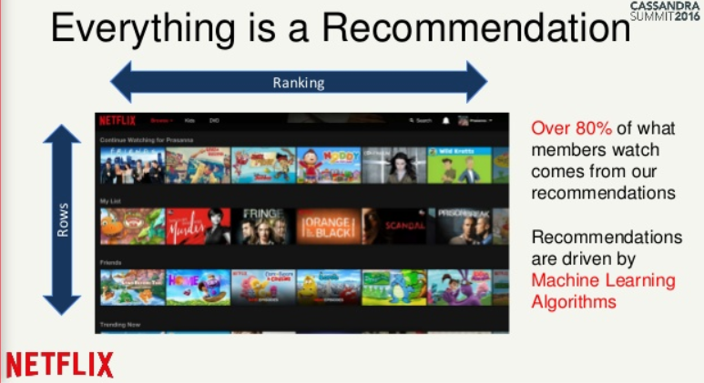
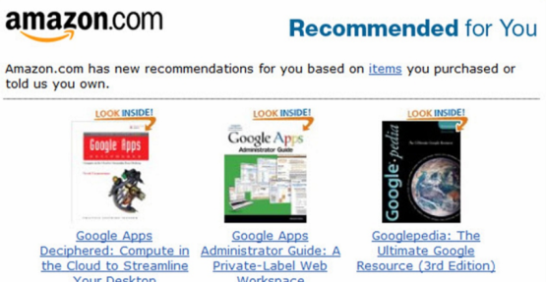

What is Recommendation System?
Recommender systems are systems that give users, the information of items/products they may like.
Became part of social networking, retail and entertainment industries , etc.
To increase sales.

Slide 3
Types of Techniques and data used for recommendation
Types of Recommendations: Collaborative recommender system, Content based recommender system, Utility Based recommender system, Knowledge based recommender system, Hybrid recommender system. Implicit data: is data we gather from the user’s behaviour.
Ex: Time spent on a song, movie. What items he purchased. Explicit data: is data where we have some sort of rating.
Ex: Ratings given to a movie or a product

Slide 4
Movie recommendation system:
Objective: To build a recommendation system which recommends movies to a user.
Approach: Collaborative filtering using Alternate least Squares algorithm.
Dataset : Movielens data set.
The ratings.txt file (Size: 24.4 MB) 1 million ratings from 6000 users on 4000 movies
The movies.txt file contains the names and movie ids of the movies.

Slide 5
Collaborative Filtering
Based on the commonalities between the ratings of the users, new ratings are generated.
Rating for an item, which the user hasn't rated yet are predicted.
These predictions are built upon the existing ratings of other users, who have similar ratings with the active user.
The new ratings are generated using matrix factorization.

Slide 6
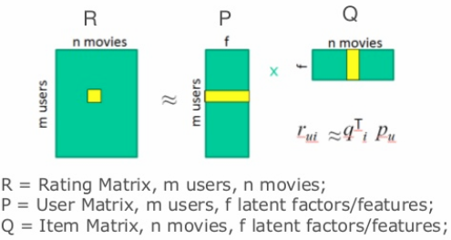
Matrix Factorization
The ratings of all the users is taken as, sparse matrix R. Now it is considered as the product of two smaller matrices. By fixing the matrices, we get closer to the actual ratings.

Slide 7
Alternate Least Squares Algorithm:
The matrix R is considered to be the product of two matrices P and Q.
So the matrix factorization is done alternatively i.e. by fixing P, Q value is estimated and similarly by fixing Q, P value is estimated.
After enough number of iterations, we are aiming to reach a convergence point where either the matrices P and Q are no longer changing or the change is quite small and then the product of the two matrices gives the predicted ratings.

Slide 8
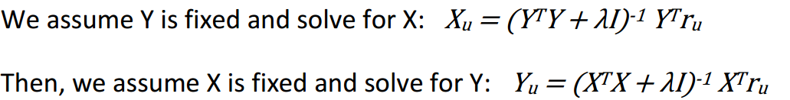

Implementation
Read the ratings file to an RDD and convert it to matrix format.
Generate two matrices with X --M*K and Y--N*K (M = no of users, N = no of movies , K = 15(Hidden latent features )
Formulas to fix matrices using ALS :
Formula to calculate RMSE :
Steps 3 and 4 are repeated for 20 iterations. The final R matrix is used for predictions.

Slide 9
The operations in calculating the matrix are independent which gives a possibility of parallelization.
Parallelization: the elements of the collection are copied to form a distributed dataset that can be operated on in parallel. The matrix which is to be estimated is parallelized and the other matrix which is assumed to be fixed is broadcasted.
Broadcasting: Broadcast variables allow the programmer to keep a read-only variable cached on each machine rather than shipping a copy of it with tasks. They can be used, for example, to give every node a copy of a large input dataset in an efficient manner.
This reduces the cost of communication and time of execution.

Slide 10
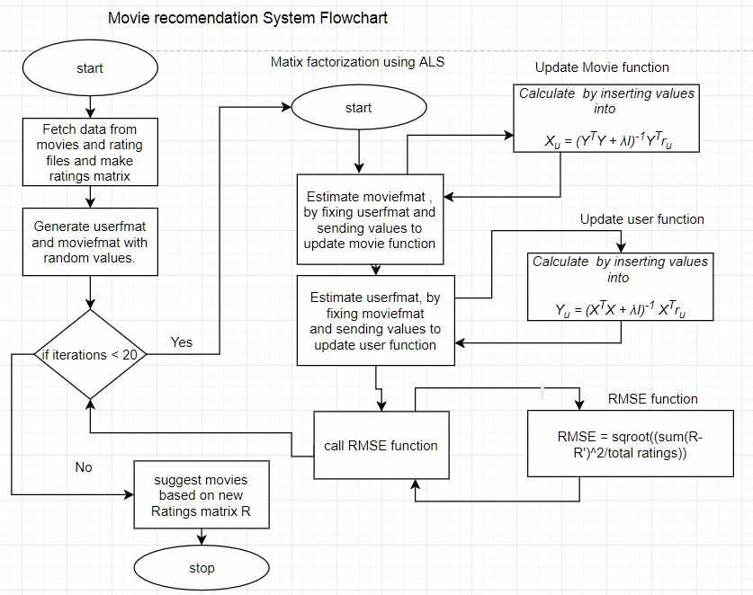
Flow chart

Slide 11
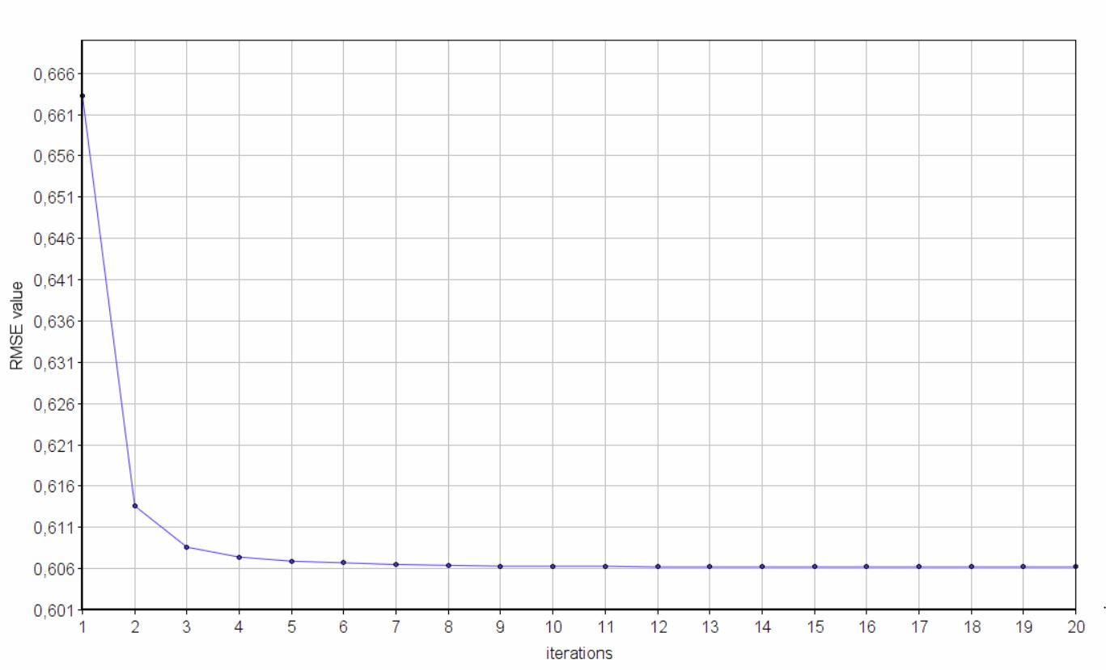
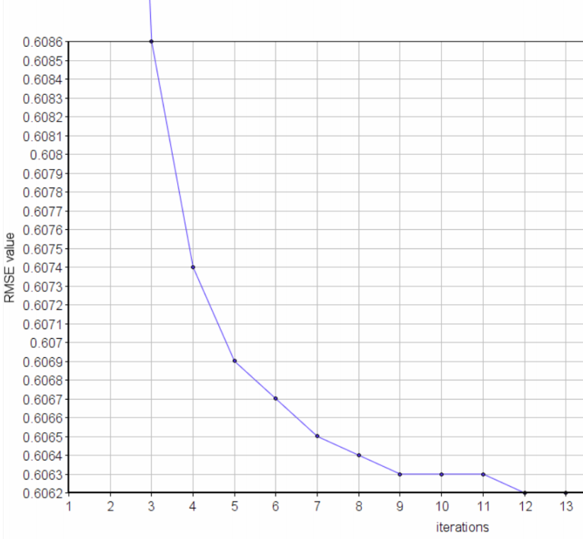
Results
The running time of the program is 7.44 min (best of 3 runs).
Graph plotted RMSE vs Iterations

Slide 12
Lessons learnt:
Check for the extra blank line in input files.
Make the number of partitions wisely.

Slide 13

Any Questions ????

Slide 14


